Slide 1
Phishing Awareness Training
(Understanding Phishing attacks & prevention)
Presented By:-
Aadarsh Tiwari
(Code Alpha Intern)

Slide 2
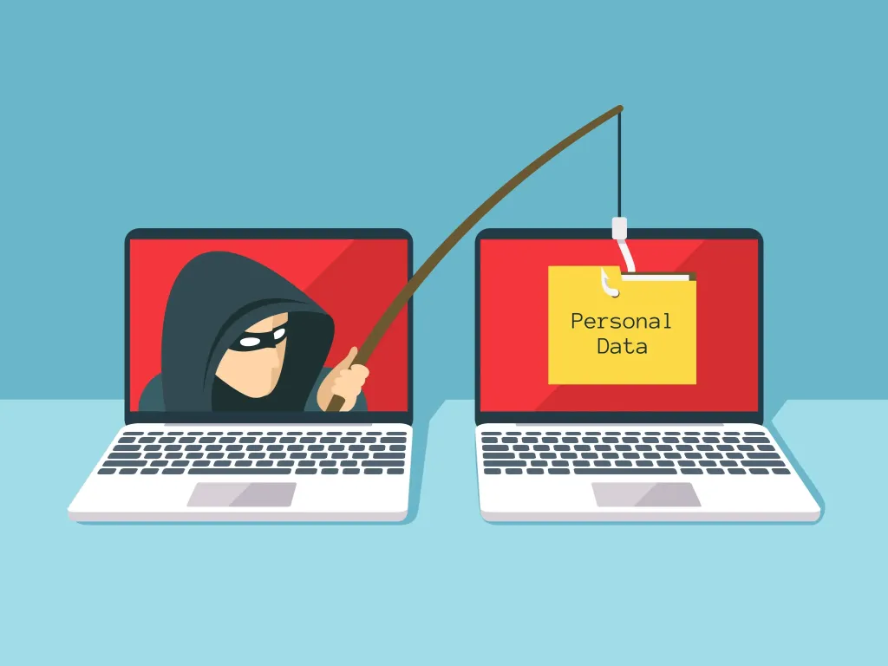
What is Phishing?
Phishing is a type of cyber attack.
Attackers pretend to be trusted organizations (bank, Google, Amazon).
They try to steal personal or financial information.
Example:
Fake email saying “Your account will be blocked”

Slide 3
Why is Phishing Dangerous?
Financial Loss:
Phishing attacks can lead to direct loss of money when attackers gain access to bank accounts, credit cards, or UPI details.
Identity Theft:
Attackers can steal personal information such as Aadhaar details, PAN, email IDs, and misuse them for illegal activities.

Slide 4
Account Compromise:
Email, social media, and work accounts can be hacked, leading to data misuse or further attacks.
Data Breaches:
Phishing can expose sensitive personal or organizational data, causing privacy violations.
Malware and Ransomware Attacks:
Clicking on malicious links or attachments can install harmful software on the system.
Loss of Trust and Reputation:
Organizations may lose customer trust if their users fall victim to phishing attacks.

Slide 5
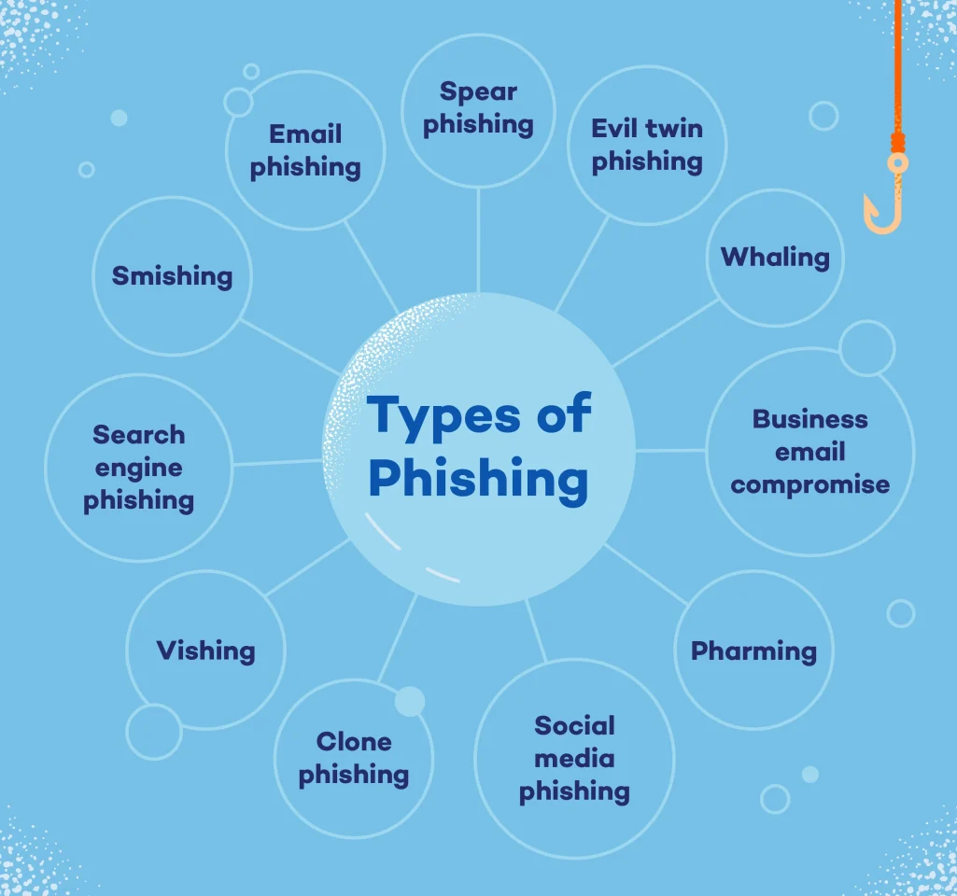
Types of Phishing Attacks

Slide 6
Email Phishing:
Fake emails pretending to be from trusted organizations to steal information.
SMS Phishing (Smishing):
Fraudulent messages with malicious links or urgent warnings.
Voice Phishing (Vishing):
Fake phone calls asking for OTPs, PINs, or bank details.
Website Phishing:
Fake websites that look like real ones to capture login credentials.
Social Media Phishing:
Fake messages or links on platforms like WhatsApp, Instagram, or Facebook.
Spear Phishing:
Targeted attacks aimed at specific individuals or organizations.

Slide 7
How to Recognize Phishing Emails?
Urgent or Threatening Language
Messages like “Act now” or “Account will be blocked”.
Unknown or Suspicious Sender
Email address does not match the organization.

Slide 8
Spelling and Grammar Errors
Poorly written or unprofessional content.
Suspicious Links or Attachments
Links that look unusual or attachments you didn’t expect.
Requests for Sensitive Information
Asking for passwords, OTPs, or bank details.
Look at an example phishing email on the next slide

Slide 9
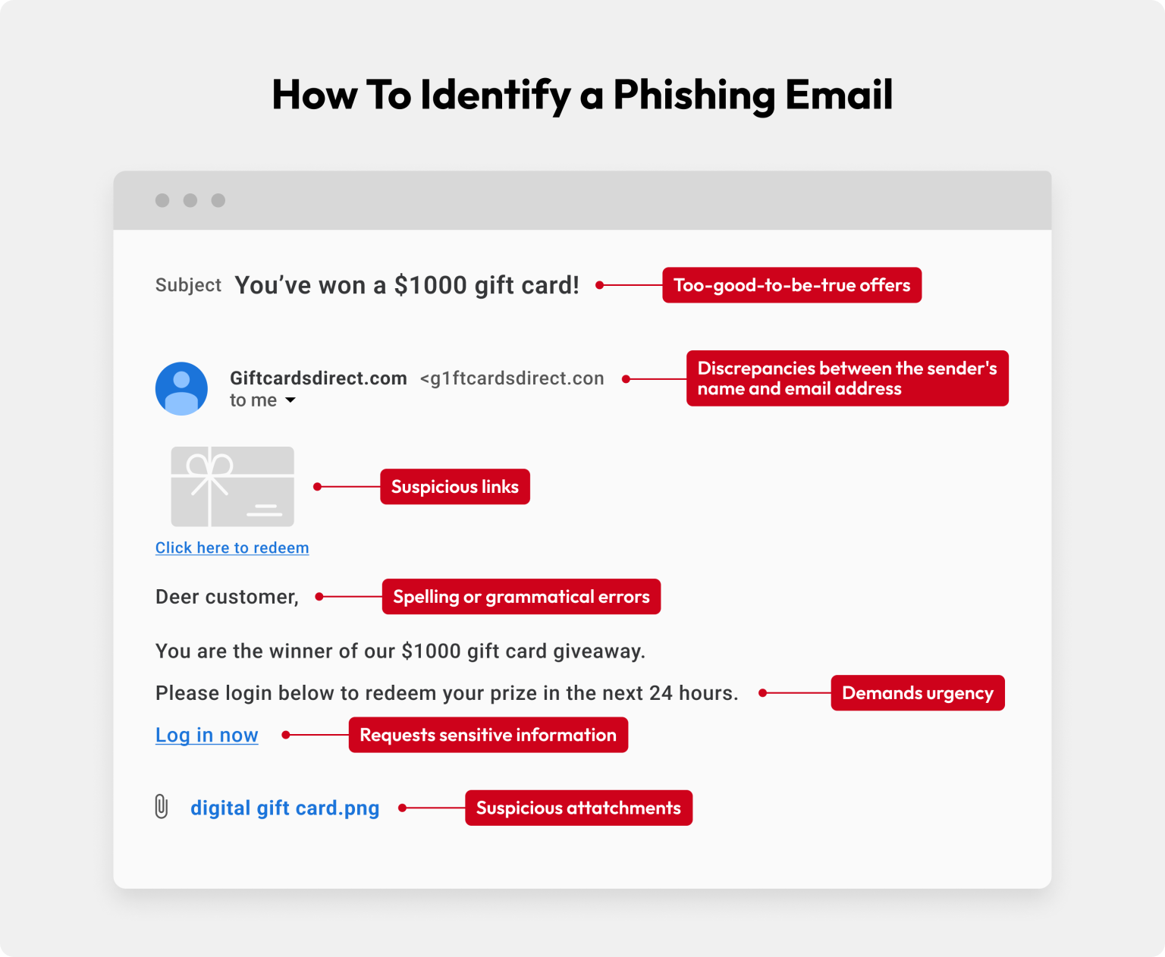

Slide 10
How to Identify Fake Websites?
Suspicious Website URL
Misspelled or strange domain names (e.g., g00gle.com).
No HTTPS Security
Missing lock icon or “https://” in the address bar.

Slide 11
Poor Website Design
Low-quality layout, broken links, or wrong logos.
Asks for Sensitive Information
Requests passwords, OTPs, or card details.
Too-Good-to-Be-True Offers
Fake prizes, discounts, or urgent offers.
Given on next slide is an example of a fake website

Slide 12
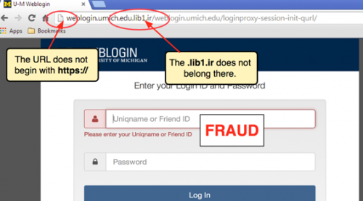

Slide 13
Social Engineering Techniques
Fear:
Threats like “Your account will be blocked” to scare users.
Urgency:
Pressuring users to act quickly without thinking.

Slide 14
Trust:
Pretending to be banks, HR, or trusted companies.
Greed / Rewards:
Fake prizes, offers, or job opportunities.
Authority:
Acting as senior officials or support staff.

Slide 15
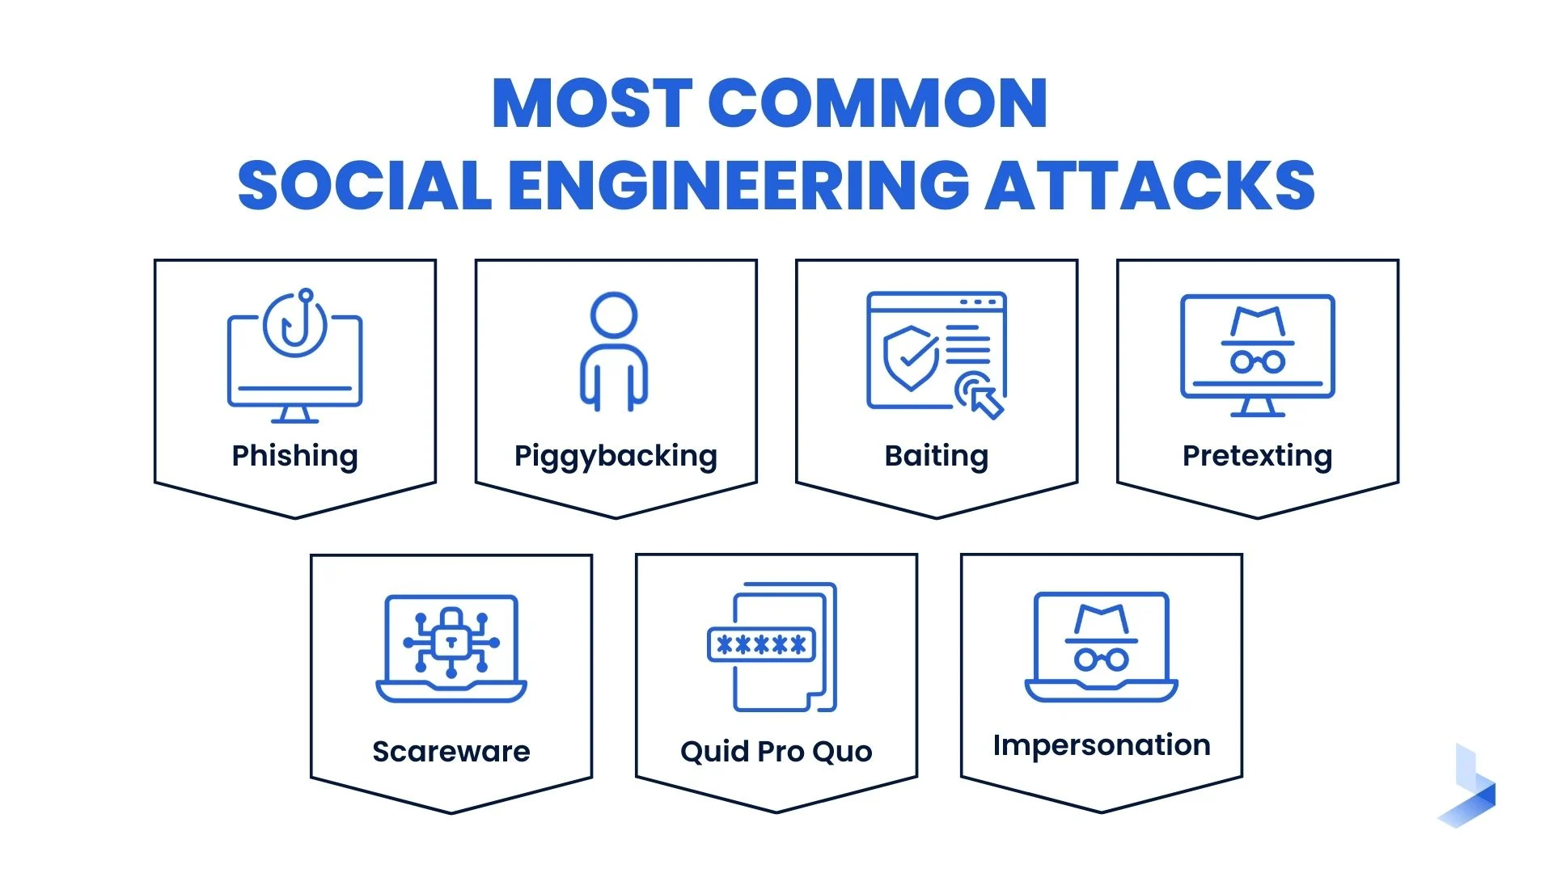

Slide 16
Real-World Phishing Examples
Now, we wil see some real-world phishing examples. Starting from the next slide.

Slide 17
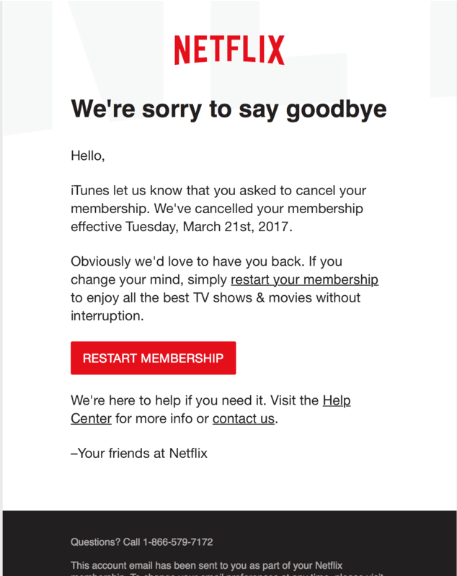
Real-World Phishing Example: Fake Netflix Email
This email pretends to be from Netflix to gain the user’s trust.
It creates urgency by saying the membership has been cancelled.
The “Restart Membership” button is used to lure users into clicking.
Clicking the button may redirect to a fake website that steals login or payment details.
The message looks professional and legitimate, making it hard to detect.

Slide 18
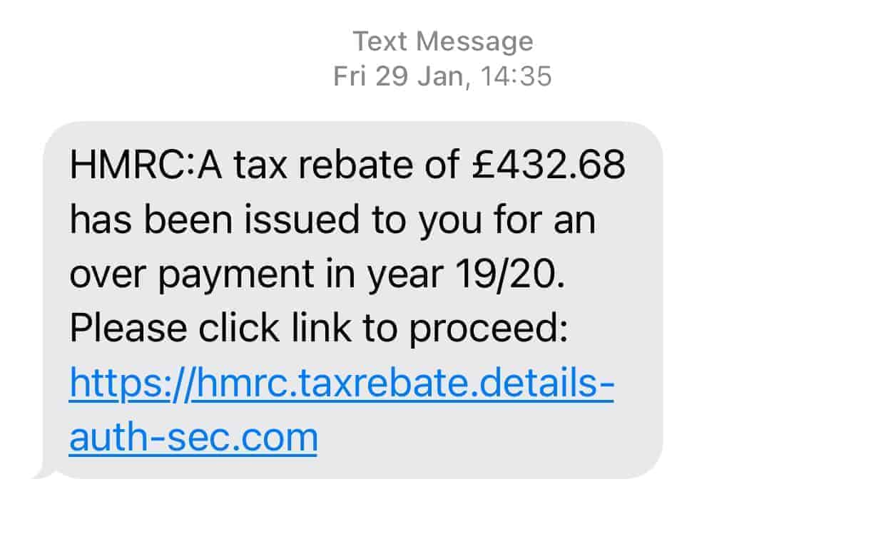

Slide 19
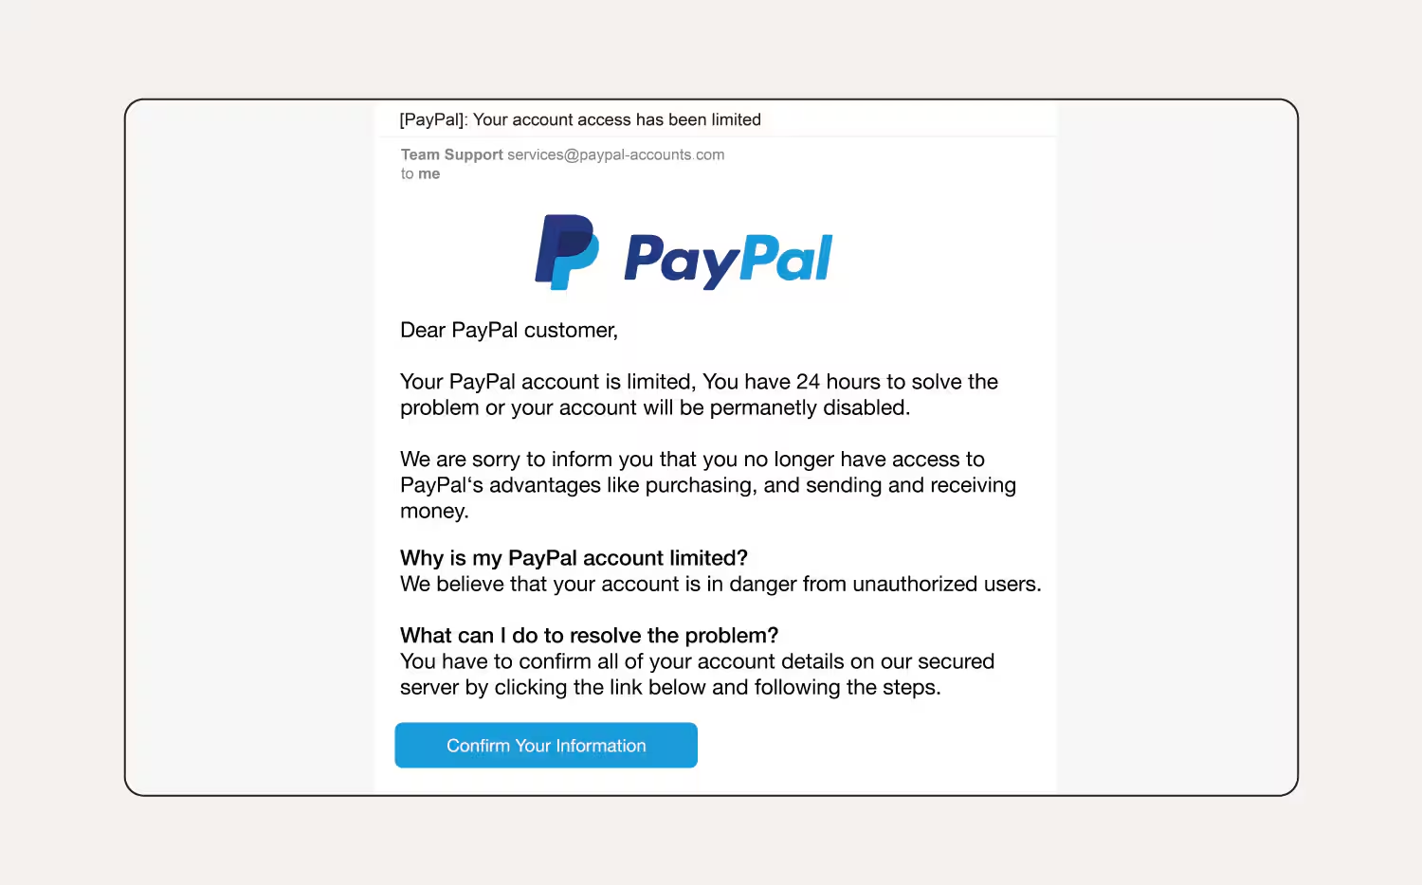

Slide 20
Best Practices to Avoid Phishing
Do Not Click Suspicious Links
Avoid links from unknown or unexpected emails/messages.
Never Share Sensitive Information
Do not share passwords, OTPs, or bank details.

Slide 21
Verify the Sender
Check email address and contact details carefully.
Use Strong Passwords & 2FA
Enable two-factor authentication for extra security.
Keep Software Updated
Regular updates protect against security threats.
Report Phishing Attempts
Inform the organization or IT/security team.

Slide 22
What To Do If You Fall Victim?
1)Change passwords immediately
2)Inform bank or service provider
3)Scan device for malware
4)Report phishing email
5)Inform IT/security team

Slide 23
Interactive Quiz
Q.1)You receive an email saying “Your bank account will be blocked in 2 hours. Click here to verify your details.” What is the biggest red flag in this message?
a) The email is from a bank
b) The message creates urgency and pressure
c) It mentions account security
d) It uses formal language
Answer:- b) The message creates urgency and pressure

Slide 24
Q.2)You hover over a link in an email and notice the URL looks strange and misspelled. What should you do next?
a) Click the link to check the website
b) Forward the email to friends
c) Delete or report the email without clicking
d) Reply asking for more details
Answer: c) Delete or report the email without clicking

Slide 25
Q.3)You receive an email from “Netflix” stating that your account is cancelled and asking you to click a link to restart your membership. What should you do?
a) Click the link immediately
b) Reply to the email for confirmation
c) Log in directly to the official Netflix website to verify
d) Share login details via email
Correct Answer: c) Log in directly to the official Netflix website to verify

Slide 26
Conclusion
Phishing attacks are increasing and target users through emails, messages, calls, and fake websites.
Attackers use social engineering techniques like urgency, fear, and trust to trick users.
Being aware of phishing signs is the best defense against cyber attacks.
Always verify links, emails, and requests before sharing any information.
Think before you click — awareness can prevent data and financial loss.
“Your awareness is your strongest security tool.”

